Slide 1

SAP Cloud Platform, Strategy and Product Management
User Interface Programming Using the Actor Model
Chris Whealy

Slide 2
Contents
Introduction to the Actor Model
  The "Shares Nothing" Principle
  Message Passing
  Supervision Trees
  The "Let it Crash" Principle
A Simple Implementation of the Actor Model
  The Mechanics of Actors & Message Passing
Summary

Slide 3
Introduction to the Actor Model
Placeholder for image and illustration scene art

Slide 4
What is the Actor Model?
The design of the Actor Model was inspired by relativistic and quantum physics, rather than the more traditional fields of mathematical logic, category theory or the Lambda Calculus.
The first paper to describe the theory behind the Actor Model was jointly published in 1973 by Carl Hewitt, Peter Bishop and Richard Steiger.
This design paradigm is based on two very simple principles:
All software is developed using primitive units of computation known as "actors"
The only way to communicate with an actor is to send it a message
Actor
Actor
Actor

Slide 5
Concurrency-Oriented Programming: The "Shares Nothing" Principle
In order for the Actor Model to be suitable for "concurrency-oriented programming", the following simple design feature must be implemented:
There can be no concept of shared memory between actors
This simple fact is all that is required to eliminate an entire category of problem in software design: namely, managing shared memory. Consequently, we do not need to worry about avoiding dead-locks, race conditions or mutexes etc.
These problems simply don't exist!
Actor
Actor
Actor
Shared Memory

Slide 6
Concurrency-Oriented Programming: Message Passing
Since every actor implements the "shares nothing" principle, the only way for actors to communicate with each other is to exchange messages.
In response to receiving a message, an actor can:
Make decisions by performing local processing, modify its internal state, and possibly changing the way it reacts to subsequent messages
Communicate the outcome of these decisions to other actors by sending them messages
Manage the life-cycle of dependent actors
Actor
Actor
Actor
Actor
Actor
Internal logic
Local memory
Actor
Actor

Slide 7
Runtime Behaviour of an Actor
All actors follow the same general pattern of runtime behaviour.
Actor
Each actor starts by performing its initialisation phase
The receive/evaluate loop starts and the actor then waits for a message
When a message is received, it is pattern matched against a set of known messages, and if recognised, is processed
The receive/evaluate loop restarts
The actor terminates when it receives some specific "stop" message
Initialise
MSG
Receive/Evaluate Loop
Stop
Terminate

Slide 8
Fault Tolerance: Supervision Trees
Since one actor can create or destroy dependent actors, it becomes possible to create hierarchies of actors known as "supervision trees".
Any actor that creates further actors immediately becomes their "supervisor", and the created actors become known as "workers". The supervisor is then responsible for handling all aspects of its worker's life-cycle, which includes all necessary recovery logic.
A supervision tree is the basic architecture needed for a very simple, yet highly robust, approach to both fault tolerance and scalability.
Actor
= supervisor
= worker
Actor
Actor
Actor
Supervisor Tree
= supervisor & worker
Actor
Actor

Slide 9

Fault Tolerance: The "Let it Crash" Principle 1/4
It is said that there are only two certainties in life: death and taxes. However, as all programmers know, there is a third certainty – at some point in time, your software is going to crash!
Therefore, rather than weighing down your application with large quantities of defensive code in an attempt to avoid the inevitable, the Actor Model takes a simpler, and much more pragmatic approach:
"Since software failure is inevitable, don't fight it, just let it crash"
Actor
Actor
Actor
Actor
Actor
Actor

Slide 10
Fault Tolerance: The "Let it Crash" Principle 2/4
The "Let it Crash" principle provides for a very clear separation of concerns:
A worker contains only application/business logic (I.E. it does not contain any defensive code!)
A supervisor contains only the code needed to manage the life-cycle of its workers. A large part of this is the error recovery logic.
This means that a worker is focused entirely on performing its required business task, and has no need for defensive code. Should it fail at anytime, it makes no attempt at self-recovery; instead, it relies on its supervisor to decide how recovery should be performed.
Actor
Actor
Actor
Actor
Actor
Actor

Slide 11
Fault Tolerance: The "Let it Crash" Principle 3/4
The Actor Model's approach to software failure creates a very simple division of labour:
Workers: Let 'em crash
Supervisors: Decide how to recover
The supervisor examines the cause of the worker's crash and then chooses from one of 4 options:
Resume the failed actor, preserving its current properties (I.E. ignore the error)
Restart the failed actor from its initial properties
Permanently terminate the failed actor
Fail itself and pass the error up to its supervisor
Actor
Actor
Actor
Actor
Actor
Actor

Slide 12
Fault Tolerance: The "Let it Crash" Principle 4/4
By enforcing a strict separation between business logic in workers and life-cycle management logic (error recovery) in supervisors, the Actor Model creates an environment in which a software crash does not propagate through the entire system since it is typically confined to small, localised branch of the supervision tree.
The overall result is that you now have a very robust, fault-tolerant architecture.
Even though individual branches of the supervision tree might fail, the system as a whole continues to run.

Slide 13
A Simple Implementation of the Actor Model
The Mechanics of Actors & Message Passing
Placeholder for image and illustration scene art

Slide 14
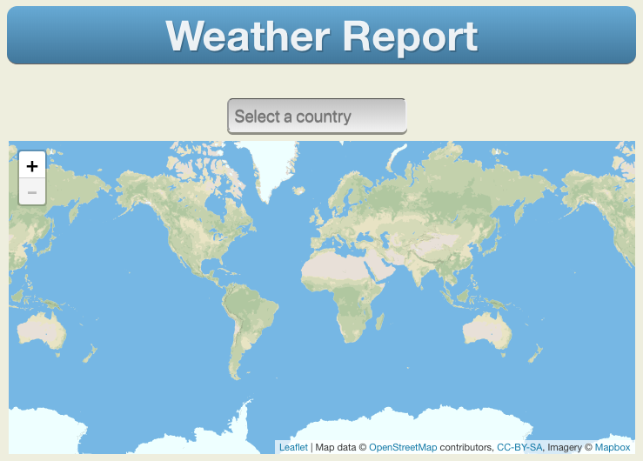
The Mechanics of Actors & Message Passing 1/4
Weather.main()
Start the program by calling Weather.main()
Create all the actors
(this app is too simple to require a supervision tree)
Initialise the country list actor
Initialise the map actor
Wait for user input
CountryListActor
RegionListActor
CityListActor
MapActor
WeatherReportActor
Backend System
FetchJsonActor

Slide 15
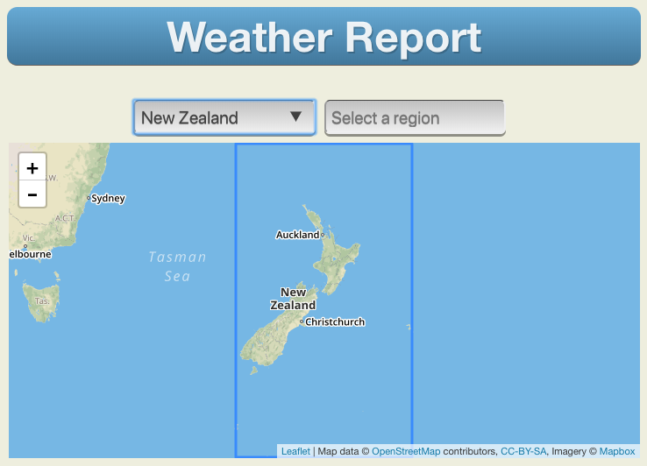
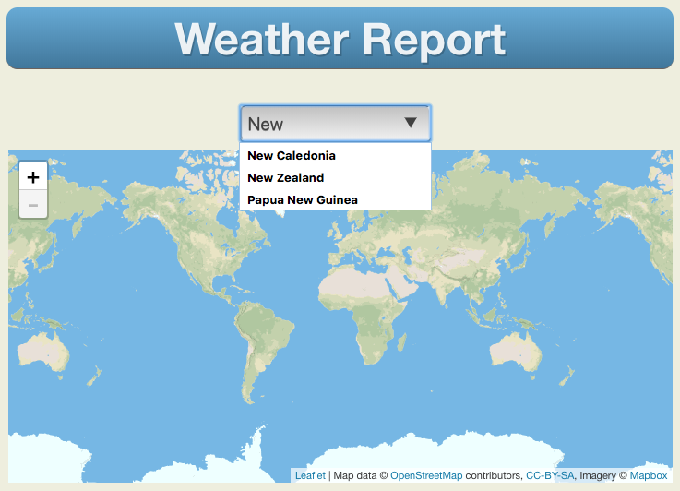
The Mechanics of Actors & Message Passing 2/4
Weather.main()
When the user selects a country, a message is sent to the country list actor
The country list actor tells the Fetch JSON actor to get the data for the selected country
The Fetch JSON actor requests the country data from a backend server
The country data is returned directly to the region list actor
The region list actor does two things:
  It tells the map actor to reposition the map on the selected country
  It builds the region list
CountryListActor
RegionListActor
CityListActor
MapActor
WeatherReportActor
Backend System
FetchJsonActor

Slide 16
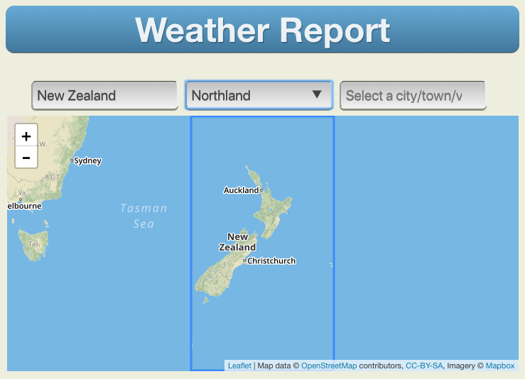
The Mechanics of Actors & Message Passing 3/4
Weather.main()
When the user selects a region, a message is sent to the region list actor
The region list actor tells the Fetch JSON actor to get the city data for the selected region
The Fetch JSON actor requests the city data from a backend server
The city data is returned directly to the city list actor
The city list actor then builds the city list
CountryListActor
RegionListActor
CityListActor
MapActor
WeatherReportActor
Backend System
FetchJsonActor

Slide 17

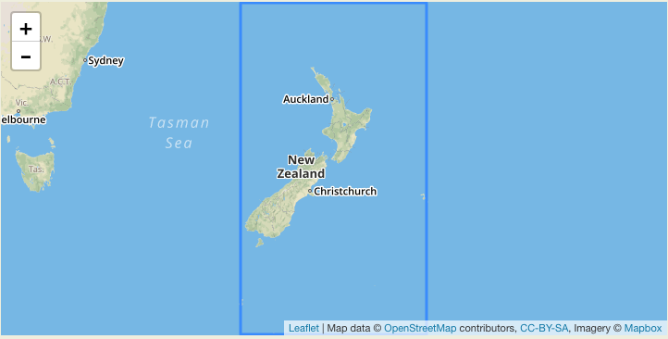
The Mechanics of Actors & Message Passing 4/4
Weather.main()
When the user selects a city, a message is sent to the city list actor
The city list actor does two things:
  It tells the map actor to zoom in on the selected city
  It tells the Fetch JSON actor to get the weather data for the selected city
The Fetch JSON actor requests the weather data from a backend server
The weather data is returned directly to the weather report actor
The weather report actor builds the weather report
CountryListActor
RegionListActor
CityListActor
MapActor
WeatherReportActor
Backend System
FetchJsonActor

Slide 18
Summary
Placeholder for image and illustration scene art

Slide 19
Actor Model: Summary of Benefits 1/3
At the heart of the Actor Model are two very simple, yet powerful concepts:
The primitive unit of code is the actor.
Since there is no concept of shared memory between actors, the only way for actors to communicate is to exchange messages: hence, the receive/evaluate loop built into every actor.
These simple concepts allow the Actor Model to provide a natural solution for:
Concurrency-Oriented Programming
Programming concurrent software is not easy because it relies on being able to handle asynchronous events. Several other coding constructs are used for this task, but none offer the natural fit provided by the Actor Model.
The combination of the "shares nothing" principle together with message-based communication eliminates an entire category of problem: namely, managing shared memory.
This in turn, makes the development of concurrent software much easier.

Slide 20
Actor Model: Summary of Benefits 2/3
At the heart of the Actor Model are two very simple, yet powerful concepts:
The primitive unit of code is the actor.
Since there is no concept of shared memory between actors, the only way for actors to communicate is to exchange messages: hence, the receive/evaluate loop built into every actor.
These simple concepts allow the Actor Model to provide a natural solution for:
Elastic Scalability
The messages exchanged between actors are location agnostic. This means when a new actor is created, there is no restriction for that actor to exist within the same VM or even on the same physical computer. The actors related to a single software system can exchange messages with each other, even though they are spread out across as multiple servers.
Further to this, the "hard scalability boundary" imposed by the thread or memory capacity of a VM is no longer a restriction.*
* This benefit depends on the specific implementation of the Actor Model

Slide 21
Actor Model: Summary of Benefits 3/3
At the heart of the Actor Model are two very simple, yet powerful concepts:
The primitive unit of code is the actor.
Since there is no concept of shared memory between actors, the only way for actors to communicate is to exchange messages: hence, the receive/evaluate loop built into every actor.
These simple concepts allow the Actor Model to provide a natural solution for:
Highly Fault Tolerant, Robust Software System
The "Let It Crash" approach to error handling, combined with the "Resume", "Restart", "Terminate" or "Fail" approach to error recovery creates an infrastructure within which very robust, highly fault tolerant systems can be constructed.
When actors crash, the errors do not propagate throughout the entire system since they are typically confined to small sections of the supervision tree. This allows for small, localised parts of the system to fail, but the system as a whole keeps running.

Slide 22
Weather App Development Summary
Development Language
This demo app has been developed using Idea IntelliJ and written in Scala using the Akka Actor framework, then compiled to JavaScript using ScalaJS.
Geographic Information
The country/region/city information was downloaded from https://github.com/prograhammer/countries-regions-cities
Weather Information
Weather report information is obtained from Open Weather Map
Source Code
All the source code for this app can be downloaded from this GitHub repo

Slide 23
© 2018 SAP SE or an SAP affiliate company. All rights reserved.
No part of this publication may be reproduced or transmitted in any form or for any purpose without the express permission of SAP SE or an SAP affiliate company.
The information contained herein may be changed without prior notice. Some software products marketed by SAP SE and its distributors contain proprietary software components
of other software vendors. National product specifications may vary.
These materials are provided by SAP SE or an SAP affiliate company for informational purposes only, without representation or warranty of any kind, and SAP or its affiliated companies shall not be liable for errors or omissions with respect to the materials. The only warranties for SAP or SAP affiliate company products and services are those that are
set forth in the express warranty statements accompanying such products and services, if any. Nothing herein should be construed as constituting an additional warranty.
In particular, SAP SE or its affiliated companies have no obligation to pursue any course of business outlined in this document or any related presentation, or to develop or release any functionality mentioned therein. This document, or any related presentation, and SAP SE’s or its affiliated companies’ strategy and possible future developments, products, and/or platform directions and functionality are all subject to change and may be changed by SAP SE or its affiliated companies at any time for any reason without notice. The information in this document is not a commitment, promise, or legal obligation to deliver any material, code, or functionality. All forward-looking statements are subject to various
risks and uncertainties that could cause actual results to differ materially from expectations. Readers are cautioned not to place undue reliance on these forward-looking statements, and they should not be relied upon in making purchasing decisions.
SAP and other SAP products and services mentioned herein as well as their respective logos are trademarks or registered trademarks of SAP SE (or an SAP affiliate company)
in Germany and other countries. All other product and service names mentioned are the trademarks of their respective companies.
See http://global.sap.com/corporate-en/legal/copyright/index.epx for additional trademark information and notices.

